Slide 1
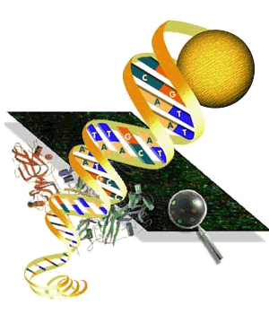
Gene annotation
How do you identify genes
in a DNA sequence?

Slide 2
What does this mean?
ATATCTTAGA GGGAGGGCTG AGGGTTTGAA GTCCAACTCC TAAGCCAGTG 1-50 CCAGAAGAGC CAAGGACAGG TACGGCTGTC ATCACTTAGA CCTCACCCTG 51-100 TGGAGCCACA CCCTAGGGTT GGCCAATCTA CTCCCAGGAG CAGGGAGGGC 101-150 AGGAGCCAGG GCTGGGCATA AAAGTCAGGG CAGAGCCATC TATTGCTTAC 151-200 ATTTGCTTCT GACACAACTG TGTTCACTAG CAACCTCAAA CAGACACCAT 201-250 GGTGCACCTG ACTCCTGAGG AGAAGTCTGC CGTTACTGCC CTGTGGGGCA 251-300 AGGTGAACGT GGATGAAGTT GGTGGTGAGG CCCTGGGCAG GTTGGTATCA 301-350 AGGTTACAAG ACAGGTTTAA GGAGACCAAT AGAAACTGGG CATGTGGAGA 351-400 CAGAGAAGAC TCTTGGGTTT CTGATAGGCA CTGACTCTCT CTGCCTATTG 401-450 GTCTATTTTC CCACCCTTAG GCTGCTGGTG GTCTACCCTT GGACCCAGAG 451-500 GTTCTTTGAG TCCTTTGGGG ATCTGTCCAC TCCTGATGCT GTTATGGGCA 501-550 ACCCTAAGGT GAAGGCTCAT GGCAAGAAAG TGCTCGGTGC CTTTAGTGAT 551-600 GGCCTGGCTC ACCTGGACAA CCTCAAGGGC ACCTTTGCCA CACTGAGTGA 601-650 GCTGCACTGT GACAAGCTGC ACGTGGATCC TGAGAACTTC AGGGTGAGTC 651-700 TATGGGACCC TTGATGTTTT CTTTCCCCTT CTTTTCTATG GTTAAGTTCA 701-750 TGTCATAGGA AGGGGAGAAG TAACAGGGTA CAGTTTAGAA TGGGAAACAG 751-800 ACGAATGATT GCATCAGTGT GGAAGTCTCA GGATCGTTTT AGTTTCTTTT 801-850 ATTTGCTGTT CATAACAATT GTTTTCTTTT GTTTATTCTT GCTTTCTTTT 851-900 TTTTTCTTCT CCGCAATTTT TACTATTATA CTTAATGCCT TAACATTGTG 901-950 TATAACAAAA GGAAATATCT CTGAGATACA TTAAGTAACT TAAAAAAAAA 951-1000
CTTACACAGT CTGCCTAGTA CATTACTATT TGGAATATAT GTGTGCTTAT 1001-1050 TTGCATATTC ATAATCTCCC TACTTTATTT TCTTTTATTT TTAATTGATA 1051-1100 CATAATCATT ATACATATTT ATGGGTTAAA GTGTAATGTT TTAATATGTG 1101-1150 TACACATATT GACCAAATCA GGGTAATTTT GCATTTGTAA TTTTAAAAAA 1151-1200 TGCTTTCTTC TTTTAATATA CTTTTTGTTT ATCTTATTTC TAATACTTTC 1201-1250 CCTAATCTCT TTCTTTCAGG GCAATAATGA TACAATGTAT CATGCCTCTT 1251-1300 TGCACCATTC TAAAGAATAA CAGTGATAAT TTCTGGGTTA AGGCAATAGC 1301-1350 AATATTTCTG CATATAAATA TTTCTGCATA TAAATTGTAA CTGATGTAAG 1351-1400 AGGTTTCATA TTGCTAATAG CAGCTACAAT CCAGCTACCA TTCTGCTTTT 1401-1450 ATTTTATGGT TGGGATAAGG CTGGATTATT CTGAGTCCAA GCTAGGCCCT 1451-1500 TTTGCTAATC ATGTTCATAC CTCTTATCTT CCTCCCACAG CTCCTGGGCA 1501-1550 ACGTGCTGGT CTGTGTGCTG GCCCATCACT TTGGCAAAGA ATTCATCCCA 1551-1600 CCAGTGCAGG CTGCCTATCA GAAAGTGGTG GCTGGTGTGG CTAATGCCCT 1601-1650 GGCCCACAAG TATCACTAAG CTCGCTTTCT TGCTGTCCAA TTTCTATTAA 1651-1700 AGGTTCCTTT GTTCCCTAAG TCCAACTACT AAACTGGGGG ATATTATGAA 1701-1750 GGGCCTTGAG CATCTGGATT CTGCCTAATA AAAAACATTT ATTTTCATTG 1751-1800 CAATGATGTA TTTAAATTAT TTCTGAATAT TTTACTAAAA AGGGAATGTG 1801-1850 GGAGGTCAGT GCATTTAAAA CATAAAGAAA TGATGAGCTG TTCAAACCTT 1851-1900 GGGAAAATAC ACTATATCTT AAACTCCATG AAAGAA 1901-1936
Notes:
β-globin

Slide 3
Gene annotation:
To identify the genes (functional units) in raw sequenced data
Predicting genes
Two components:
  1. Computer based programs
  2. Manual (required for in-depth analysis and accuracy)

Slide 4
Steps in gene annotation
Identify and eliminate (mask) repeats (intergenic DNA)
Examine reading frames RF1, RF2, RF3 to determine coding sequence
Determine open reading frame
Identify splice sites for introns (often start with GT and end with AG)
UTR & promoters (TATA box)
Poly-A Tail
Verifying your predictions with homology assessment

Slide 5
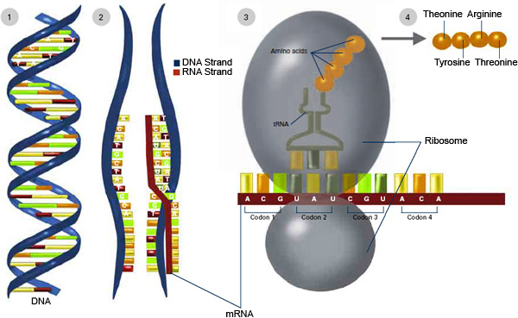
The Central Dogma
Notes:
1. RNA polymerase transcribes DNA to make messenger RNA (mRNA). 2. The mRNA sequence (dark red strand) is complementary to the DNA sequence (blue strand). 3. On ribosomes, transfer RNA (tRNA) helps convert mRNA into protein. 4. Amino acids link up to make a protein

Slide 6
Review –DNA to protein
https://www.youtube.com/watch?v=D3fOXt4MrOM
  DNA to Protein
Alternative videos
DNA Transcription Animation
http://www.hhmi.org/biointeractive/dna-transcription-basic-detail
http://www.dnai.org/a/index.html
  Transcription video
https://www.youtube.com/watch?v=nHM4UUVHPQM
  Animation - less like molecules

Slide 7
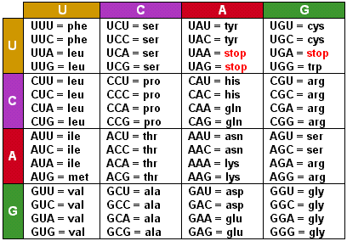
Protein Codons

Slide 8
Where are the genes?
What are features which identify genes?
What is intergenic DNA?
Gene boundaries are difficult to determine from DNA:
  Use mRNA and protein codons

Slide 9
Is it a meaningful sequence?
Frequency analysis: Compare the ratios for each element and element combinations to deduce whether a sequence contains information or is random gibberish.
Random: If the elements occur in roughly equal ratios, the sequence may be random;
Meaningful: If they occur in different ratios, the sequence may have meaning.
GeneBoy: http://www.dnai.org/geneboy/index.html

Slide 10
Meaningful Sequence?
GeneBoy:
http://www.dnai.org/geneboy/index.html
Comparisons
 | Sequences | Operations | Panel
1. | Random 1 | Analyze Composition | Pairs* - chart - clone
 | Genic 1 | Analyze Composition | Pairs* - chart
* Also try singles & triplets
2. | Intergenic 1 | Analyze Composition | Pairs – chart - clone
 | Random 2 | Analyze Composition | Pairs – chart
Notes:
However, the nucleotide ratios in DNA – whether genic or intergenic – show a non-random pattern. This provides evidence that the whole genome, not just genes, has been subjected to evolutionary selection.

Slide 11
Meaningful Sequence?
GeneBoy:
http://www.dnai.org/geneboy/index.html
  Comparisons
 | Sequences | Operations | Panel
3. | Genic 2 | Analyze Operations | Single– chart - clone
 | Intergenic 2 | Analyze Operations | Single – chart
4. | Genic 2 | Analyze Operations | Pair – chart - clone
 | Intergenic 2 | Analyze Operations | Pair – chart
What single rule could a computer use to identify gene-rich regions of the human genome?
Notes:
The proportions for the different nucleotides vary between genic and intergenic DNA.
The ratios of different nucleotide pairs vary greatly between genic and intergenic DNA.Look closely at the charts of frequencies of nucleotide pairs, and try the comparison with a different set of genic and intergenic sequences.What single rule could a computer use to identify gene-rich regions of the human genome?
Search for regions with elevated G and C (GC) content, particularly high frequency of the CG dinucleotide.Gene density, in fact, increases with GC content. This represents the lowest recognizable level of organization of the human genome – perhaps a remnant of early selection events in the evolution of genes. The CG dinucleotide is notably depleted in intergenic regions and enriched in genic regions. CG "islands," are often associated with sequences that regulate gene transcription.

Slide 12
Intergenic DNA: Abundance of repeats
Example: TATATATATATATATATATATATATATATATA
Abundance of repeats in DNA (eukaryotes)
  2 – 6 nucleotides long
  Dozen to several hundred repeats
Mask: Replace with “N” or use small a,t,c,g
Notes:
Repeats can be low complexity (as shown in the example) or transposable elements such as viruses (also LINES – long interspersed nuclear elements or SINE ) which were incorporated into the DNA. Human genome may consist of 47% of repeats.

Slide 13
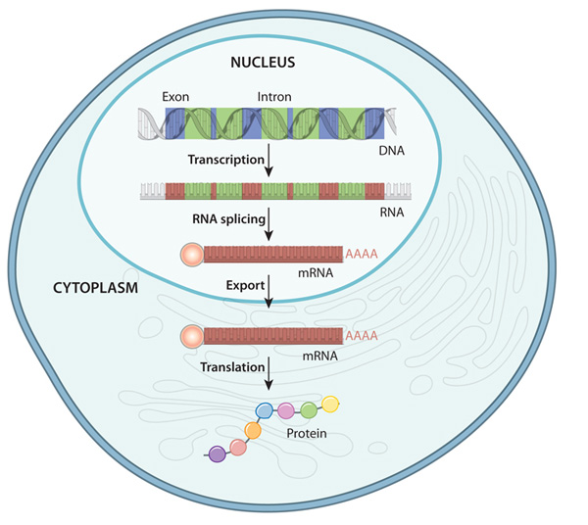
Add to Favorites
Image may be subject to copyright. Learn more.
Genes are complex with both structure and regulatory features.
Often, mRNA must
be examined to
determine the
DNA structure.

Slide 14
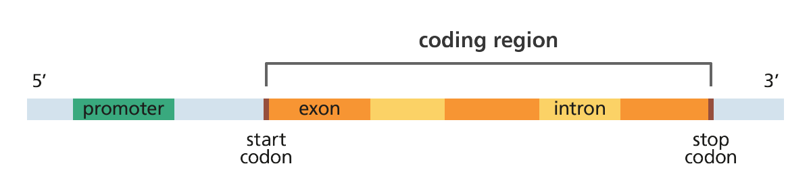
Structure of mRNA
Credit: Genome Research Limited
http://www.yourgenome.org/facts/how-do-you-identify-the-genes-in-a-genome

Slide 15
Start and Stop Codons
Notes:
Most proteins begin with the amino acid methionine (MET), so the MET codon is considered the "start" codon.
The stop codons UAA, UAG, and UGA, corresponding to the DNA sequences TAA, TAG, and TGA, can be searched for as the end of a protein coding sequence.

Slide 16
Reading Frames: RF1, RF2, RF3
Example: AUCAUGCACCUGAGUCAUCCGGUAA
RF1 AUCAUGCACCUGAGUCAUCCGGUAA
RF2 UCAUGCACCUGAGUCAUCCGGUAA
RF3 CAUGCACCUGAGUCAUCCGGUAA
Activity: Reading Frame Translation
Use Gene Boy: http://www.dnai.org/geneboy/index.html
Notes:
After a start codon, successive codons in a gene sequence are "read" three nucleotides at a time, until a stop codon is encountered. However, the codons in any DNA sequence can be "read" in three different ways, depending on whether one starts at the first nucleotide position, the second or third. Each of these different ways is referred to as a reading frame (RF).

Slide 17
Reading Frame Practice
5’ TTGATTCATG ATATTTTACT CCAAGATACA AATGAATCAT GGAGAAATCT GCTTTCT 3’

Slide 18
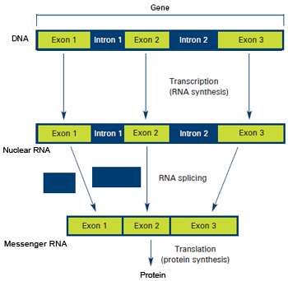
Exons & Introns - Eukaryotes
Note:
DNA
Nuclear RNA
(pre-mRNA)
mDNA
Notes:
Genes in most more complex organisms have 3-8 exons with a few dozen to a few thousand nucleotides. During transcription, the entire gene is copied into pre-mRNA, which includes exons and introns.
(nuclear RNA or pre-mRNA)
During the process of RNA splicing, introns are removed and exons are joined to form a contiguous coding sequence, which is now ready for translation

Slide 19
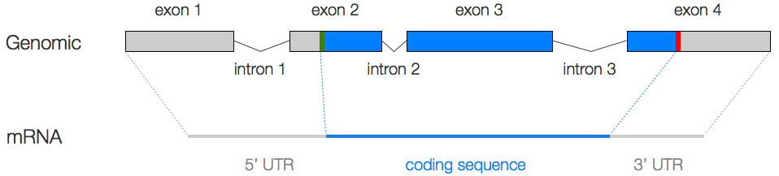
Open Reading Frame (ORF)
UTR = untranslated region: transcription start site
Part of the 1st & last exons
For Translation
Notes:
This nucleotide sequence – containing a start codon, a long string of triplet codons, and a stop codon – is called an open reading frame (ORF).
Genes in prokaryotes, such as bacteria, usually consist of ORFs bounded by start and stop codons. Some eukaryotic genes are simple ORFs that can be identified by the location of the start and stop codons. However, most eukaryotic genes contain noncoding sequences that confound the search for ORFs, so other gene features need to be considered.
TRANSCRIPTION begins with the 5' UTR and ends with the 3' UTR, but TRANSLATION begins with the start codon (ATG), and ends with a stop codon (TAA, TAG, or TGA).

Slide 20
Animation – Intron splicing
https://www.dnalc.org/view/16938-3D-Animation-of-RNA-Splicing.html

Slide 21
Identifying Intron Sequences: GT/AG Rule
Exon/intron borders
Often start with GU(GT)
End with AG
Note:
Nuclear RNA
(pre-mRNA)
Notes:
Across eukaryotes, most introns start with GU and/or end with AG, sequences represented in DNA by GT and AG. Because of their commonoccurrence, splice sites that adhere to the GT or AG schemata are called "canonical" splice sites.However, since the GT and AG di-nucleotides are common in DNA, merely searching for GT and AG will turn up many false exons, as well as a fewreal ones. Clearly, a different search scheme is needed. Computer programs that search for introns first look for GTs and AGs. A matrix is then used to score the surrounding nucleotides of the consensus sequence. For example, a GT followed by A or G would score much higher than a GT followed by a T or C

Slide 22
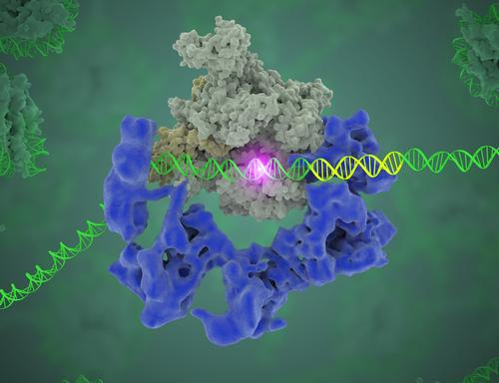
Promoters:
DNA sequences in the 5’ region, adjacent to the transcription site
TFIID complex binds DNA to start gene transcription
Source: Eva Nogales, Berkeley Lab

Slide 23
Promoters - TATA Box
DNA sequences in the 5’ region, adjacent to the transcription site.
Used to regulate gene activity.
Common promoter sequences (TATA Box) found 25 – 35 nucleotides before the start site
Example: TATATA for human keratin
TATATT for albumin genes
Notes:
Promoters are DNA sequences located in the 5' region adjacent to the transcriptional start site. RNA polymerase and accessory proteins (transcription factors) bind to the promoter to initiate production of an mRNA transcript. Interactions of proteins at the promoter regulate gene activity by activating or repressing transcription.Scientists have identified promoter sequences that act as binding sites for RNA polymerase and a variety of transcription factors.

Slide 24
See DNA Subway Background
http://dnasubway.iplantcollaborative.org/#
Structure: Page 15

Slide 25
mRNA –polyA tails
At the 3’ UTR, number of “A” nucleotides added
Helps to stabilize the mature mRNA
AAAAAAAAAAAAAAAAAAAAAA
5’ UTR
3’ UTR
In mRNA, the consensus signal is A(A/U)UAAA, in which the second position (A/U) may be either A or U.
In DNA, this corresponds to the consensus sequence A(A/T)TAAA.
Notes:
The Three Prime Untranslated Region (3’UTR) is the region of DNA after the stop codon in a gene. Once it is transcribed, a polyA tail is added that helps to stabilize the mRNA. These regions sometimes have binding sites to microRNAs that, when present, signal the mRNA for break down.

Slide 26
GeneBoy - Gene Finding ?
http://www.dnai.org/geneboy/index.html
 | Sequences | Operations | Panel
 | Genic 1 | Find Genes | ORFs
 | Genic 1

Slide 27
Examining a sequence:
Exons (Codons for amino acids: Start: ATG Stop: TAG, TGA, or TAA.
Introns: GT/AG rule
Promoters: TATA box
ATATCTTAGA GGGAGGGCTG AGGGTTTGAA GTCCAACTCC TAAGCCAGTG 1-50 CCAGAAGAGC CAAGGACAGG TACGGCTGTC ATCACTTAGA CCTCACCCTG 51-100 TGGAGCCACA CCCTAGGGTT GGCCAATCTA CTCCCAGGAG CAGGGAGGGC 101-150 AGGAGCCAGG GCTGGGCATA AAAGTCAGGG CAGAGCCATC TATTGCTTAC 151-200 ATTTGCTTCT GACACAACTG TGTTCACTAG CAACCTCAAA CAGACACCAT 201-250 GGTGCACCTG ACTCCTGAGG AGAAGTCTGC CGTTACTGCC CTGTGGGGCA 251-300 AGGTGAACGT GGATGAAGTT GGTGGTGAGG CCCTGGGCAG GTTGGTATCA 301-350 AGGTTACAAG ACAGGTTTAA GGAGACCAAT AGAAACTGGG CATGTGGAGA 351-400 CAGAGAAGAC TCTTGGGTTT CTGATAGGCA CTGACTCTCT CTGCCTATTG 401-450 GTCTATTTTC CCACCCTTAG GCTGCTGGTG GTCTACCCTT GGACCCAGAG 451-500 GTTCTTTGAG TCCTTTGGGG ATCTGTCCAC TCCTGATGCT GTTATGGGCA 501-550 ACCCTAAGGT GAAGGCTCAT GGCAAGAAAG TGCTCGGTGC CTTTAGTGAT 551-600 GGCCTGGCTC ACCTGGACAA CCTCAAGGGC ACCTTTGCCA CACTGAGTGA 601-650 GCTGCACTGT GACAAGCTGC ACGTGGATCC TGAGAACTTC AGGGTGAGTC 651-700 TATGGGACCC TTGATGTTTT CTTTCCCCTT CTTTTCTATG GTTAAGTTCA 701-750 TGTCATAGGA AGGGGAGAAG TAACAGGGTA CAGTTTAGAA TGGGAAACAG 751-800 ACGAATGATT GCATCAGTGT GGAAGTCTCA GGATCGTTTT AGTTTCTTTT 801-850 ATTTGCTGTT CATAACAATT GTTTTCTTTT GTTTATTCTT GCTTTCTTTT 851-900 TTTTTCTTCT CCGCAATTTT TACTATTATA CTTAATGCCT TAACATTGTG 901-950 TATAACAAAA GGAAATATCT CTGAGATACA TTAAGTAACT TAAAAAAAAA 951-1000
CTTACACAGT CTGCCTAGTA CATTACTATT TGGAATATAT GTGTGCTTAT 1001-1050 TTGCATATTC ATAATCTCCC TACTTTATTT TCTTTTATTT TTAATTGATA 1051-1100 CATAATCATT ATACATATTT ATGGGTTAAA GTGTAATGTT TTAATATGTG 1101-1150 TACACATATT GACCAAATCA GGGTAATTTT GCATTTGTAA TTTTAAAAAA 1151-1200 TGCTTTCTTC TTTTAATATA CTTTTTGTTT ATCTTATTTC TAATACTTTC 1201-1250 CCTAATCTCT TTCTTTCAGG GCAATAATGA TACAATGTAT CATGCCTCTT 1251-1300 TGCACCATTC TAAAGAATAA CAGTGATAAT TTCTGGGTTA AGGCAATAGC 1301-1350 AATATTTCTG CATATAAATA TTTCTGCATA TAAATTGTAA CTGATGTAAG 1351-1400 AGGTTTCATA TTGCTAATAG CAGCTACAAT CCAGCTACCA TTCTGCTTTT 1401-1450 ATTTTATGGT TGGGATAAGG CTGGATTATT CTGAGTCCAA GCTAGGCCCT 1451-1500 TTTGCTAATC ATGTTCATAC CTCTTATCTT CCTCCCACAG CTCCTGGGCA 1501-1550 ACGTGCTGGT CTGTGTGCTG GCCCATCACT TTGGCAAAGA ATTCATCCCA 1551-1600 CCAGTGCAGG CTGCCTATCA GAAAGTGGTG GCTGGTGTGG CTAATGCCCT 1601-1650 GGCCCACAAG TATCACTAAG CTCGCTTTCT TGCTGTCCAA TTTCTATTAA 1651-1700 AGGTTCCTTT GTTCCCTAAG TCCAACTACT AAACTGGGGG ATATTATGAA 1701-1750 GGGCCTTGAG CATCTGGATT CTGCCTAATA AAAAACATTT ATTTTCATTG 1751-1800 CAATGATGTA TTTAAATTAT TTCTGAATAT TTTACTAAAA AGGGAATGTG 1801-1850 GGAGGTCAGT GCATTTAAAA CATAAAGAAA TGATGAGCTG TTCAAACCTT 1851-1900 GGGAAAATAC ACTATATCTT AAACTCCATG AAAGAA 1901-1936
Notes:
β-globin

Slide 28
ATATCTTAGA GGGAGGGCTG AGGGTTTGAA GTCCAACTCC TAAGCCAGTG 1-50 CCAGAAGAGC CAAGGACAGG TACGGCTGTC ATCACTTAGA CCTCACCCTG 51-100 TGGAGCCACA CCCTAGGGTT GGCCAATCTA CTCCCAGGAG CAGGGAGGGC 101-150 AGGAGCCAGG GCTGGGCATA AAAGTCAGGG CAGAGCCATC TATTGCTTAC 151-200 ATTTGCTTCT GACACAACTG TGTTCACTAG CAACCTCAAA CAGACACCAT 201-250 GGTGCACCTG ACTCCTGAGG AGAAGTCTGC CGTTACTGCC CTGTGGGGCA 251-300 AGGTGAACGT GGATGAAGTT GGTGGTGAGG CCCTGGGCAG GTTGGTATCA 301-350 AGGTTACAAG ACAGGTTTAA GGAGACCAAT AGAAACTGGG CATGTGGAGA 351-400 CAGAGAAGAC TCTTGGGTTT CTGATAGGCA CTGACTCTCT CTGCCTATTG 401-450 GTCTATTTTC CCACCCTTAG GCTGCTGGTG GTCTACCCTT GGACCCAGAG 451-500 GTTCTTTGAG TCCTTTGGGG ATCTGTCCAC TCCTGATGCT GTTATGGGCA 501-550 ACCCTAAGGT GAAGGCTCAT GGCAAGAAAG TGCTCGGTGC CTTTAGTGAT 551-600 GGCCTGGCTC ACCTGGACAA CCTCAAGGGC ACCTTTGCCA CACTGAGTGA 601-650 GCTGCACTGT GACAAGCTGC ACGTGGATCC TGAGAACTTC AGGGTGAGTC 651-700 TATGGGACCC TTGATGTTTT CTTTCCCCTT CTTTTCTATG GTTAAGTTCA 701-750 TGTCATAGGA AGGGGAGAAG TAACAGGGTA CAGTTTAGAA TGGGAAACAG 751-800 ACGAATGATT GCATCAGTGT GGAAGTCTCA GGATCGTTTT AGTTTCTTTT 801-850 ATTTGCTGTT CATAACAATT GTTTTCTTTT GTTTATTCTT GCTTTCTTTT 851-900 TTTTTCTTCT CCGCAATTTT TACTATTATA CTTAATGCCT TAACATTGTG 901-950 TATAACAAAA GGAAATATCT CTGAGATACA TTAAGTAACT TAAAAAAAAA 951-1000
CTTACACAGT CTGCCTAGTA CATTACTATT TGGAATATAT GTGTGCTTAT 1001-1050 TTGCATATTC ATAATCTCCC TACTTTATTT TCTTTTATTT TTAATTGATA 1051-1100 CATAATCATT ATACATATTT ATGGGTTAAA GTGTAATGTT TTAATATGTG 1101-1150 TACACATATT GACCAAATCA GGGTAATTTT GCATTTGTAA TTTTAAAAAA 1151-1200 TGCTTTCTTC TTTTAATATA CTTTTTGTTT ATCTTATTTC TAATACTTTC 1201-1250 CCTAATCTCT TTCTTTCAGG GCAATAATGA TACAATGTAT CATGCCTCTT 1251-1300 TGCACCATTC TAAAGAATAA CAGTGATAAT TTCTGGGTTA AGGCAATAGC 1301-1350 AATATTTCTG CATATAAATA TTTCTGCATA TAAATTGTAA CTGATGTAAG 1351-1400 AGGTTTCATA TTGCTAATAG CAGCTACAAT CCAGCTACCA TTCTGCTTTT 1401-1450 ATTTTATGGT TGGGATAAGG CTGGATTATT CTGAGTCCAA GCTAGGCCCT 1451-1500 TTTGCTAATC ATGTTCATAC CTCTTATCTT CCTCCCACAG CTCCTGGGCA 1501-1550 ACGTGCTGGT CTGTGTGCTG GCCCATCACT TTGGCAAAGA ATTCATCCCA 1551-1600 CCAGTGCAGG CTGCCTATCA GAAAGTGGTG GCTGGTGTGG CTAATGCCCT 1601-1650 GGCCCACAAG TATCACTAAG CTCGCTTTCT TGCTGTCCAA TTTCTATTAA 1651-1700 AGGTTCCTTT GTTCCCTAAG TCCAACTACT AAACTGGGGG ATATTATGAA 1701-1750 GGGCCTTGAG CATCTGGATT CTGCCTAATA AAAAACATTT ATTTTCATTG 1751-1800 CAATGATGTA TTTAAATTAT TTCTGAATAT TTTACTAAAA AGGGAATGTG 1801-1850 GGAGGTCAGT GCATTTAAAA CATAAAGAAA TGATGAGCTG TTCAAACCTT 1851-1900 GGGAAAATAC ACTATATCTT AAACTCCATG AAAGAA 1901-1936
Notes:
Assessment
The following is the nucleotide sequence of the human b-globin gene. Gene regions are indicated as follows: Untranscribed, Transcribed but not translated, Transcribed and Translated (red), Conserved Sequence. Nucleotide positions in the DNA are shown in the right hand margin.
Assessment
The following is the nucleotide sequence of the human b-globin gene. Gene regions are indicated as follows: Untranscribed, Transcribed but not translated, Transcribed and Translated, Conserved Sequence. Nucleotide positions in the DNA are shown in the right hand margin.

Slide 29
What are Reading Frames?
“Gene” Sequence: thecatatetherat.
Reading Frame +1 starts at the first letter:
the cat ate the rat.
Reading Frame +2 starts at the second letter:
t hec ata tet her at.
Reading Frame +3 starts at the third letter:
th eca tat eth era t.
Reading Frames -1, -2 & -3 would be like reading the sentence “backwards.”
The period at the end of the sentence is like a stop codon.
Open Reading Frame: the cat ate the rat.
Notes:
Slide 9

Slide 30
How Do We Know Where to
Start Translation?
Reading Frame +1
5’- CCGATGTCATAAGAC - 3’
3’- GGCTACAGTATTCTG - 5’
Notes:
Slide 10

Slide 31
How Do We Know Where to
Start Translation?
Reading Frame +1 P M S STOP
5’- CCGATGTCATAAGAC - 3’
3’- GGCTACAGTATTCTG - 5’
Notes:
Slide 11

Slide 32
How Do We Know Where to
Start Translation?
Reading Frame +2 R C H K
5’- CCGATGTCATAAGAC - 3’
Reading Frame +1 P M S STOP
5’- CCGATGTCATAAGAC - 3’
3’- GGCTACAGTATTCTG - 5’
Notes:
Slide 12

Slide 33
How Do We Know Where to
Start Translation?
Reading Frame +2 R C H K
5’- CCGATGTCATAAGAC - 3’
Reading Frame +1 P M S STOP
5’- CCGATGTCATAAGAC - 3’
3’- GGCTACAGTATTCTG - 5’
Reading Frame -1 R H STOP L V
Notes:
Slide 13

Slide 34
Add to Favorites
Image may be subject to copyright. Learn more.
How DNA becomes a protein

Slide 35
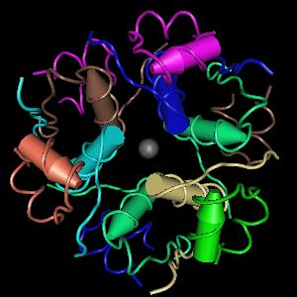
How DNA becomes a protein
DNA Gene
Exon 1
Exon 2
Promoter
5’ UTR
CDS 1
Intron
CDS 2
3’ UTR
5’
ATG…
GT
AG
…TGA
Transcription
Pre-mRNA
AUG…
GU
AG
…UGA
RNA processing: Removal of introns addition of 5’ cap and poly-A tail
Mature mRNA
AAAAAAAAAAAAAAAAAAAAAA
AUG…
…UGA
Poly-A tail
Translation
Protein

Slide 36

